Slide 1

COVID-19 Online Training in Kenya
Amref Health Africa
www.amref.org

Slide 2
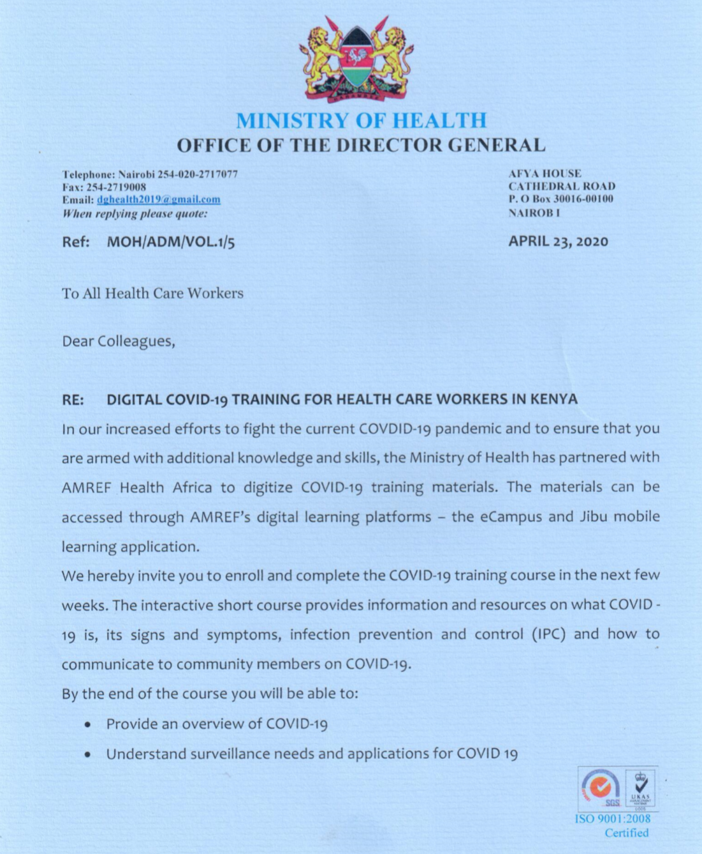
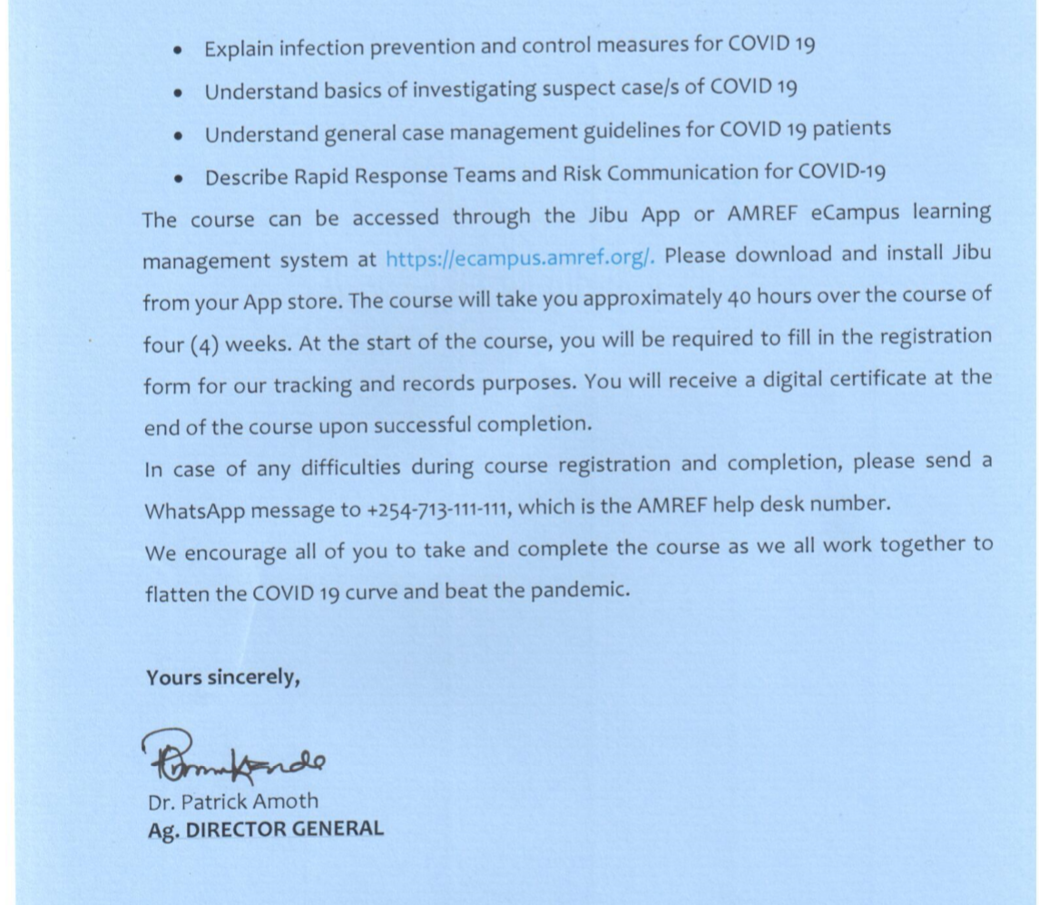
MOH COVID-19 Training - HCPs
Amref Health Africa has partnered with the Kenya MoH to offer a COVID-19 course through the Jibu mobile learning app
The course has 3 modules developed by the Ministry and digitized by Amref
The course takes approximately 40 hours to complete
Upon course completion, the HCWs receive:
    Digital certificates (signed by MOH & Amref) and
    CPD points, which supports their license renewal

Slide 3

Engagement with stakeholders
1. Amref has engaged and agreed with regulators to offer CPD points:
      Nursing Council of Kenya
      Clinical Officers Council
      Pharmacy & Poisons Board
      Association of Medical Records Officers – Kenya
      Kenya Nutrition & Dietetics Institute
      Medical Practitioners & Dentist Board
  Discussions with the other regulators are ongoing

Slide 4
Course outline
Module 1: Overview of COVID-19
Introduction to COVID-19
Integrated Disease Surveillance and Response (IDSR)
Enhanced COVID-19 Surveillance
COVID-19 Laboratory Diagnostics for Health Care Workers
Module 2: IPC Measures for COVID -19
Infection Prevention & Control (IPC) Measures for Covid-19
Case Investigation of COVID-19
Healthcare Waste Management
Cleaning and Disinfection of Environment and Equipment
Cleaning, Disinfection and Chlorine Mixtures
Infection Prevention & Control (IPC) Practices in a COVID-19 Quarantine Centre
COVID-19 Case Management
Occupational Health and Safety in the Context of COVID-19
Safe Handling of Deceased Bodies of COVID-19
- Home Based Isolation and Care for COVID-19
Module 3: Rapid response teams (RRT) and communication for COVID-19
- Rapid Response Teams (RRT) and Communication for COVID 19
- Rapid Response Teams at Health Facility Level
- Risk Communication
- Mental Health & Psychosocial Support

Slide 5
Current statistics

Slide 7
Registration by cadre- Registration vs Completion

Slide 8
Sector comparisons

Slide 9
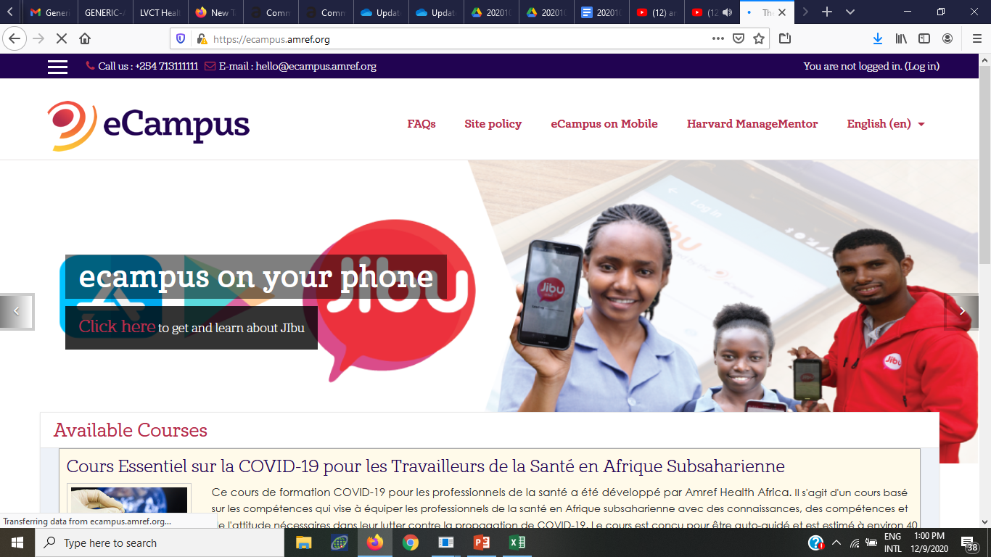
How to access the course
Play video
https://www.youtube.com/watch?v=mIaEBsciF_w&t=156s

Slide 10
Way forward
Created an e-Flier which is being distributed via different media (emails, WhatsApp, Telegram etc) highlighting course content, certification, no cost to health worker.
2. Encourage many of our colleagues to register for the course

Slide 11
www.amref.org

