Slide 1
HEALTH CARE WORKER IN COVID19 ERA
BY TABITHA NDUTA MATEKWA
NEPHROLOGY NURSE
COUNSELING PSYCHOLGY
KENYATTA NATIONAL HOSPITAL

Slide 2
KENYAN NURSE
KENYAN NURSE IS AMONG THE MANY HEALTH CARE WORKERS WHO ARE ON THE FRONT LINE TO FIGHT COVID19.
AS A FRONTLINER THERE IS A LOT OF ANXIETY AND FEAR ASSOCIATED WITH COVID 19.
THE STIGMA OF BEING A HEALTH WORKER BY COMMUNITY IS REAL.
THE NURSE HAS TO BE PRESENT TO PROVIDE CARE WITHOUT BEING WORN OUT.

Slide 3
WHAT IT MEANS TO BE WORN OUT
FATIGUE
TIRED
STRESSED
OVERWHELMED
BEING DRAINED
EMPTY BATTERY
LAMP WITHOUT OIL
TO BURNOUT –BURN OUT IS A STATEOF EMOTIONAL ,MENTAL AND PHYSICAL EXHAUSTION CAUSED BY PROLONGED STRESS.

Slide 4
NURSES CAN GIVE CARE WITHOUT BEING WORN OUT
Nurses are on the front line to fight covid 19 and they Will continue caring for patient even after the pandemic is over.
Nurses work round the clock to preserve the wellbeing of the patient and the general public.
Nurses can give care without being worn out.

Slide 5
THINGS CAUSING THE NURSE TO BE WORN OUT IN COVID 19 ERA
Workload
Environment
Renumeration
Provision of PPE
Family issues
Rising covid19 cases

Slide 6
THINGS CAUSING THE NURSE TO BE WORN OUT
POOR PATIENT NURSE RATIO
CARING FOR THE SICK
CARING FOR OUR COLLEAGUES WHO ARE ALSO SICK.
INADEQUATE TRAINING
CONCERNS ABOUT INFECTING OUR FAMILY MEMBERS.
SHORTAGE OF VENTILATORS

Slide 7
THINGS CAUSING THE NURSE TO BE WORN OUT
WHEN TOO MANY PATIENTS DIE WHILE WE ARE ON DUTY.
ALLOCATION OF PATIENTS
STIGMA
ALLIGHNING PATIENTS NEED.
LACK OF CLEAR DIRECTION.
FEAR OF INFECTION
FEAR OF ISOLATION
FEAR OF DEATH

Slide 8
IMPACT OF BEING WORN OUT
COGNITION
MEMEORY DISRUPTION/FORGETING
LOW CONCENTRATION
POOR JUDGEMENT
CONSTANT WORRY AND ANXIETY

Slide 9
EMOTIONS
IRRITABLE
SUSPICION
FRUSTRATED
ANGER
APATHY
LACK OF COMPASSION

Slide 10
BEHAVIOR IMPACT OF BEING WORN OUT
SELF ISSOLATION
WITHDRAWAL
BURN OUT
NOT LEAVING WORK
NOT INTERESTED IN WORK.
PROCRASTINATION

Slide 11
PHYSICAL IMPACT
WEIGHT GAIN OR LOSS
DIARHOEA
NAUSEA
CHESTPAIN
BACK PAIN
HEADACHES
INSOMNIA
FEELING SICK
FREQUENT INFECTION

Slide 12
INEFFECTIVE COPING
EXCESS DRINKING
SUBSTANCE ABUSE
OVER OR UNDER EATING
AVOIDING THE SITUATION
ABSENTEESM
FIGHTING
ARGUING
RESIGNING
PROCRASTINATIOM

Slide 13
HOW TO GIVE CARE WITHOUT BEING WORN OUT
TRAINING
ARM YOURSELF WITH INFORMATION AS PER M.O.H GUIDELINE IN THE WEBSITE.
EDUCATE YOURSELF ON ZOOM ,GOOGLE MEET WHATSUP,FACEBOOK,ON SOCIAL MEDIA ALL THE RELEVANT INFORMATION
TAKE PERSONAL RESPONSIBILITY

Slide 14
GIVING CARE WITHOUT BEING WORN OUT
FAMILY CARE– OUR FAMILY COME FIRST GIVE THEM RELEVANT INFORMATION
ALLAY THEIR FEARS AND WORRIES
CONNECT WITH THEM
QUALITY TIME WITH YOUR FAMILY
SUPPORT FAMILY MEMBERS WHO ARE SICK
CREATE YOUR HAPPY TIME WITH FAMILY
CREATE A BACK UP PLAN INCASE YOU ARE SICK.

Slide 15
GIVING CARE WITHOUT BEING WORN OUT
AT WORK
OBSERVE THE COVID RULE
TAKE YOUR BREAKS
AVOID OVERCROWDING.
DO WHAT YOU CAN THE BEST YOU CAN
ACCEPT WHAT YOU CANT CHANGE
LISTEN TO YOUR BODY WHEN YOU FEEL OVERWHELMED.
LEARN TO WORK AS ATEAM.

Slide 16
NURSE MANAGERS
CREATE A SUPPORTING CLIMATE.
ESTABLISH ROUTINE
APPRECIATE YOU STAFF
MANAGE INFORMATION AND BE TRANSPARENT
MONITOR THE HEALTH OF YOUR WORKERS.
MONITOR STRESS LEVELS
BIULD CAPACITY.
LEAD BY EXAMPLE AND MODEL HEALTHY WORKING ENVIRONMENT.
HELP STAFF MEMBERSTAKE CARE OF SELF

Slide 17

SELF CARE
TAKING TIME TO REPLENISH BECAUSE YOU WORK VERY HARD
SELF CARE SHOULD BE VERY INTENTIONAL

Slide 18
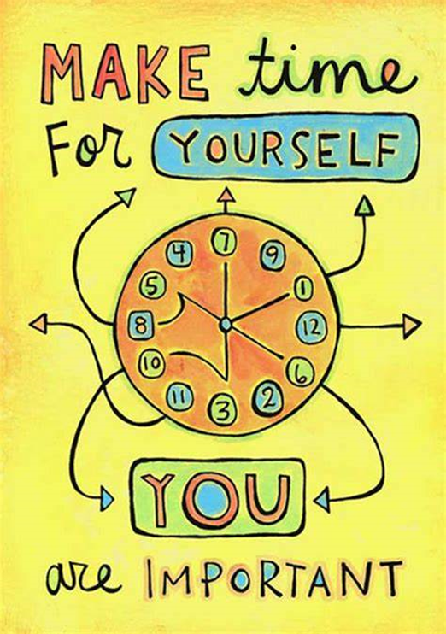
SELF CARE
PHYSICAL
SLEEP
STRETCH
EXERCISE
DIET

Slide 19
SELF CARE
PAUSE AND BREATH AND CONNECT WITH YOUR BREATH.FEEL YOUR BREATH GETTING IN AND OUT
HOW OFTEN HAVE YOU DONE THIS?
HOW OFTEN ARE ABLE TO STOP FOR A SECOND?

Slide 20
EMOTIONAL SELF CARE
STRESS MANAGEMENT
ACCEPT
ALTER AVOID
ASSERTIVENES

Slide 21
SOCIAL
SET BOUNDARIES
SUPPORT SYSTEM
POSITIVE SOCIAL MEDIA
FRIENDS WHO ADD VALUE

Slide 22
SPIRITUAL
TIME ALONE
MEDITATION
PRAYER
NATURE
SACRED TIME

Slide 23
FINANCE
SAVING
BUDGET
BILLS
BOUNDARIES

Slide 24
SELF LOVE
FORGIVE YOURSELF
FOCUS ON THE POSITIVE
HOW ARE YOU FEELING
ACCEPT HERE YOU ARE
BE OPEN TO CHANGE
BE HONEST ITH YOURSELF
BE KIND TO YOURSELF

Slide 25

KENYAN NURSE

Slide 26
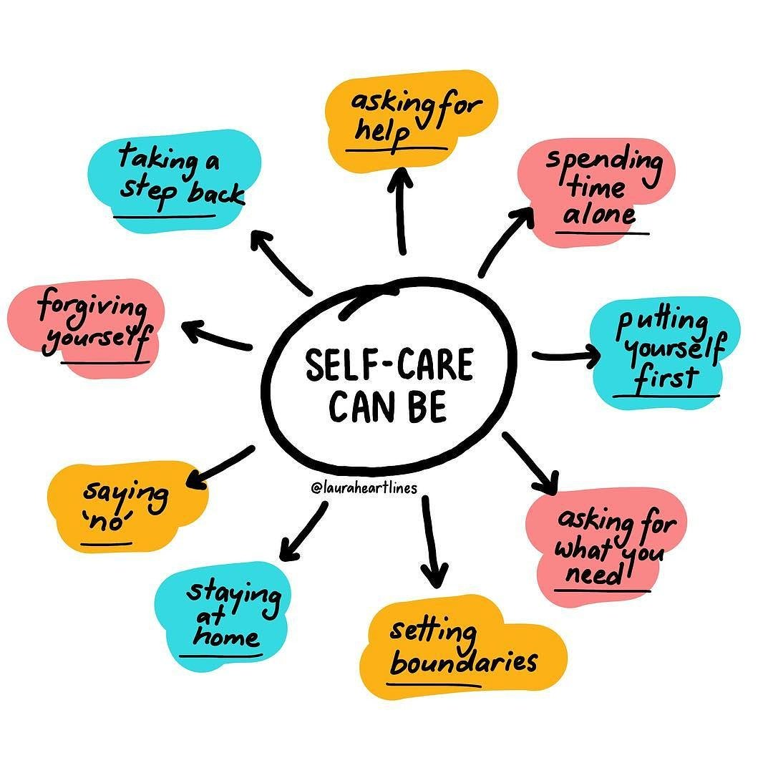
KENYAN NURSE

Slide 27
CONCLUSION
KENYAN NURSE AS YOU GIVE COMPASSION TO OTHERS REMEMBER YOU ARE THE FIRST RECEPIENT OF YOUR COMPASSION.
GENUINE ALTRUISM REQUIRE THAT YOU BE AT YOUR BEST TO GIVE YOUR BEST
YOU CAN GIVE CARE WITHOUT BEING WORN OUT
BE YOUR BROYHERS KEEPER.

Slide 28
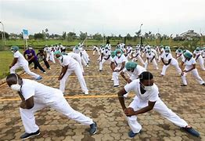
AM PROUD TO BE A KENYAN NURSE

Slide 29
THANKYOU FOR YOUR TIME
QUESTION AND ANSWERS

