Slide 1
Home Based Isolation and Care Implementation Mechanism In Kenya Dr. Judith Awinja, Head/Home Based Isolation and Care Programme December, 2020

Slide 2
Objectives
Background and rationale of HBIC
Key elements of the HBIC
The process of initiating and managing the HBIC Programme

Slide 3
Outline
Introduction
Background and Rationale/Justification
Overall goal & Strategic Objectives
Successful adoption of HBIC
Strategic guiding principles
Key roles & Responsibilities of households
Monitoring of HBIC patients by “Jitenge system”
Achievements
Implementation framework

Slide 4
Introduction

Slide 5
Introduction
HBIC for COVID 19 Patients is a totally new practice for every country in the world, just like the disease itself
Despite, WHO developing guidelines for HBC for COVID 19 patients to be customized by countries, implementation has been “a tall order” amid the fastest and high level of spread.

Slide 6
Background and Rationale

Slide 7
Background
Kenya reported its first case of COVID 19 on 13th March 2020.
On 14th June 2020, there were 3,594 laboratory confirmed COVID 19 patients (2469-Male and 1125-Female) and 103 COVID 19 related deaths.
90% Of the infected patients were cases of local transmission an indication that community transmission was on course in the month of June.
78% had mild disease or were asymptomatic.

Slide 8
Rationale/Justification

Slide 9
Rationale
Majority of COVID-19 cases are mild and asymptomatic, the high numbers are overwhelming the health system, hampering service provision for other essential services. These two were the main reasons for HBIC besides stigmatization of COVID-19

Slide 10
Successful adoption of HBIC

Slide 11
Successful adoption
The Community health volunteers are able to reach households and their local communities to educate and influence behavior change and also ensure continuum of care at the community level.
The CHVs also provide link and referral to the primary health care facilities.

Slide 12
Successful adoption
Other structures that augmented the work of the CHVs successfully are the community health committees, nyumba kumi initiatives, Estate management committees among other local administrative structures in a given community.
In this regard, there was need to build capacity & provide quality assurance to the county governments in the implementation of the home-based isolation and care guidelines across the country.

Slide 13
Overall Goal & strategic objectives

Slide 14
Overall goal for HBIC
Decongest health facilities and lessen the spread of highly infectious diseases like COVID 19

Slide 15
Strategic Objectives of HBIC

Slide 16
Strategic Objectives of HBIC
Overall: establish sustainable services towards hampering spread of highly infectious diseases like COVID 19 in households in the community,
aiming at promoting and empowering households and communities to take charge of containing the spread of COVID 19 disease and generally, their own health

Slide 17
Strategic objective cont…
Specific:
Provide Home Based Isolation and care as per the guidelines
Strengthen the capacity of caregivers and community health workers
To strengthen the linkage between community and facility based services

Slide 18
Strategic Guiding Principles

Slide 19
Strategic guide Principles
Heath Care workers to be on government payroll
Caregivers for HBIC to be nominated by the household on the basis of trust and maturity
Coordination structure to bring all actors at all levels

Slide 20
Roles and Responsibilities of Caregivers

Slide 21
General Roles amid COVID 19
General health care: overseeing medication and prescriptions usage, appointment reminders and administering medicine – In case of preexisting condition
Emotional support: being a stable companion and supporter in all matters personal, health-related and emotional
Back-up care (or respite) services: providing other caregivers a break

Slide 22
General Responsibilities amid COVID 19
Assisting with personal care: bathing and grooming, dressing, toileting, and exercise.
Basic food preparation: preparing meals, shopping, housekeeping, laundry, and other errands.
Health monitoring: following a care plan and noticing any changes in the individual’s health, recording and reporting any differences

Slide 23
General Responsibilities amid COVID 19
It is the responsibility of the Caregivers to take reports to the CHVs as their supervisors.
One CHV is responsible/supervise twenty (20) households.
One HCW Preferably a Nurse or a PHO, will supervise five (5) CHVs, And;
The HCW will report to the person in charge of the link Health facility.

Slide 24
Jitenge System Monitoring App

Slide 25
What is ‘Jitenge’ – Electronic Alert Response System (EARS) Self-quarantine APP
This is an application that guides through the process of reporting daily defined conditions of a COVID-19 exposed individual during the 14 days quarantine/isolation period.
Objective of “Jitenge” EARS APP is to provide critical data for self quarantined/Isolation cases in the country for decision making and quick intervention

Slide 26
Jitenge – Functionalities
Can be used in designated quarantine/Isolation facilities/homes and for special interest groups such as truck drivers
Client is prompted every 24 hours to report on symptoms and/or changes in health condition with multiple reminders in cases of default in reporting
Available as a mobile application and as a USSD session by dialing *299#
Notifications to health care worker in the event of a change to symptomatic or default in reporting
Allows the remote management of many clients at the same time with their records digitized
Allows geo-mapping and geo-fencing
Reports can be aggregated from quarantine/Isolation facilities and specific interest groups such as truck drivers at County and National levels

Slide 27
How it works!
Home care Case registration
Registration (either by using the ID, Passport & Mobile Number) is done.
Home care case receives an SMS with Jitenge app link
Case/Patient
Home care case start reporting symptoms via mobile app or USSD
EARS
Integration with other systems
Dashboard and analytics accessed via URL at different levels
Alerts and info is sent, for those who have not reported or with alarming symptoms
EMR/LIMS
We are able to get data reported by location through the mobile application
Alert and Notifications for home care case who hasn’t sent their daily data
Dashboard and analytics on home care cases with alarming symptoms

Slide 28
Achievements

Slide 29
Achievements
Now citizen freely accept testing
Level of stigmatization has gone down
No more fears of admission if tested positive
Family teams up in support of the patient
Freely communicates with attached HCW of any further symptoms and/or recuperation
Highest number of recoveries is from HBIC

Slide 30
Implementation framework

Slide 31
Implementation Framework
Establish Home Isolation and care package for each implementing County
Distribute supplies according to guidelines and controls
Ensure all caregivers are educated and are providing services accordingly
Facilitate health promotion amid COVID 19

Slide 32
Implementation framework cont…
Facilitate environmental sanitation, safe water supply and personal hygiene
Provide first aid and refer incase of health crisis
Establish a referral mechanism and refer COVID 19 patients when necessary.

Slide 33
Cumulative situation of COVID 19

Slide 34
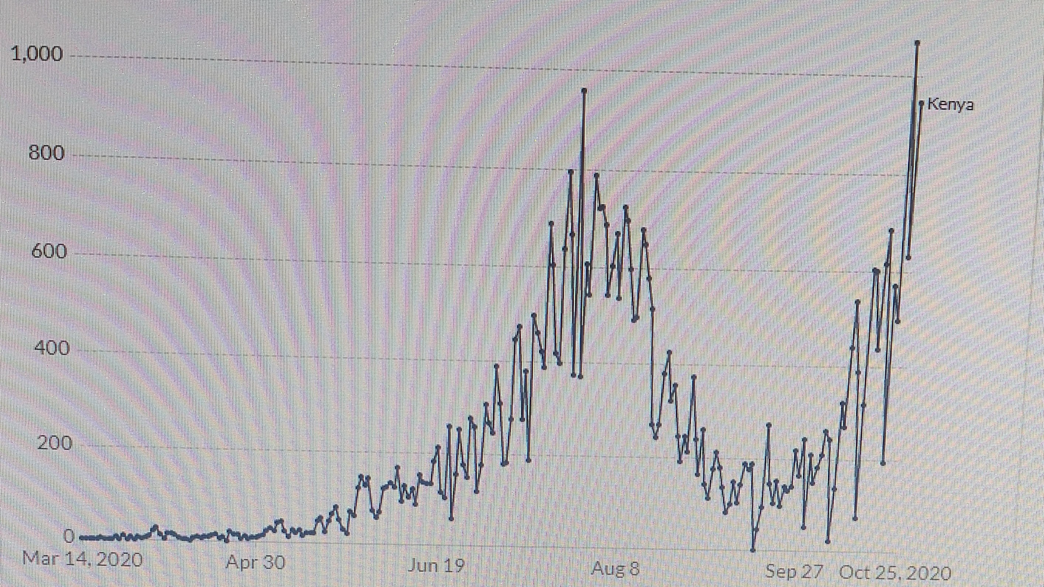

Slide 35
Advantage of HBIC
In August 2020, COVID 19 cases started declining following intensified implementation of HBIC programme.
In September 2020, the numbers went down even more prompting the President of the Republic of Kenya to ease some containment measures put in place to minimize the spread of the disease
Cumulative number of HBIC discharges as at 27th October, 2020 was ………

Slide 36
Situation as at now
In October 2020, COVID 19 cases started increase again. This could be attributed to citizens assumption that COVID 19 in Kenya is eliminated.
Secondly, the focal HCW may have relaxed (concentrate on other healthcare services) in their community supervision and intensified reminder to people to keep safe
The HCW have been very important, quite supportive and best lieutenants in implementation of HBIC, the moment they got back to their health facilities for other services the CHVs could not hundle the situation thus the October surge

Slide 37
Way forward
Intensify HCW supervision in the community. In this process,
Train all caregivers on the protocols through the existing local administrative structures (CHVs, Estate management committees and the Nyumba Kumi intiative).
Ensure all caregivers are educated and are providing services accordingly
Provide PPEs to the caregivers and remind them to follow all the protocols as provided by MOH
Counties should adhere to the HBIC protocols in order to support the families appropriately
Facilitate health promotion amid COVID 19

Slide 38
END
ASANTE SANA!
Thank you!!

