Slide 1
Role of Virtual reality and Serious Gaming in Healthcare Training:experiences and perceptions of clinical trainers
Kivuti-Bitok W.L^{1*}, Jebet J,C¹, Wanja.S,² Mutwiri M³, Njune I^{1,4}.
School of Nursing Sciences, University of Nairobi, Kenya
School of Health Sciences, St Paul’s University, Limuru Kenya
Mission for Essential Drugs and Supplies (MEDS), Kenya
Faculty of Nursing and Midwifery, Curtin University

Slide 2
Training Environment Dynamism of Clinical Insturctions
Corona Virus disease (COVID)-19 pandemic
physical distancing and reduction of the physical human touch in clinical training and service delivery.
the need for innovation and re-engineering of clinical teaching
possible increased adoption of Virtual Reality(VR) and Serious Gaming(SG) as a complimentary training method in a clinical setting.

Slide 3

Virtual Reality
-utilizes computer technology to block out the real world (Reality) and replace it with a computer-generated ‘virtual ‘reality (Mann et al. 2018).
- immersive,
- highly visual
This Photo by Unknown Author is licensed under CC BY

Slide 4
AUGUMENTED REALITY
VR elements can be added into a real-world resulting
to Augmented Reality (AR)

Slide 5
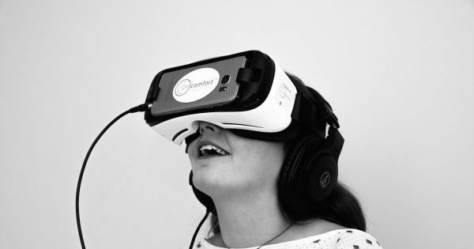
VR
-3D characteristics,
-allow the participant to look about and navigate within a seemingly real or physical world
These applications provide immersion for the user and the ability to perform complete medical procedures under various clinical fields of medical education
(Pantelidis et al. 2018).
This Photo by Unknown Author is licensed under CC BY-NC

Slide 6

Serious Gaming
-Games that are digitally enabled with the sole purpose of professional health education (Gentry et al. 2019).
- adopted at varying levels to train medical students
This Photo by Unknown Author is licensed under CC BY-NC-ND

Slide 7
ADVANTAGES OF VR&SG
VR and SG reduce the need for human contact
reduce the cost of training
simulated tasks of different levels of difficulties.
The immediate feedback offered to users reduces the need for human mentors.
The adoption of this immersive technological advancement by clinical trainers may be influenced by their experiences and perceptions.

Slide 8
SIGNIFICANCE OF OUR STUDY
several studies have focused on the experiences and perceptions of learners,
fewer studies have focused on experiences and perceptions of clinical trainers.

Slide 9
AIM OF THE STUDY
systematically review and appraise published evidence to establish the experiences of clinical trainers in the use of VR and SG
influence their perceptions and subsequent adoption trajectories in clinical instruction
Study questions
  1. What are the perspectives of clinical health care trainers regarding ease of use of VR and SG?
  2. Do clinical health care trainers intend to adopt the use of VR and SG in clinical training?

Slide 10
METHODOLOGY
We searched the following electronic databases for relevant literature; PubMed/Medline-Informit +A Education (ProQuest ERIC)-CINHAL-EBSCOhost
using a combination of the selected key words.
a pre-determined inclusion and exclusion criteria

Slide 11
Assessment of study quality
To assess the quality of the studies Two authors (IN and MM) used the Mixed method appraisal tool(MMAT)since the tool is useful for appraising quantitative, qualitative, and mixed methods studies.

Slide 12
METHODOLOGY
We evaluated 24 studies
14 studies employed virtual reality,
4 studies used mixed reality while
2 studies used virtual patients in the training of health professionals and postgraduate students.
5 studies used serious gaming technology.
2 studies combined serious gaming and virtual reality.
Only 9 studies reported on the perceptions of the trainers on VR and or SR.

Slide 13
STUDY POPULATION
Clinical trainers: Faculty, practitioners and postgraduate students involved in teaching clinical skills in healthcare training facilities.
analyze how their perspectives may influence their adoption of VR and SG using the Technology Adoption Model (TAM).

Slide 15
VR and SG in clinical instruction,
the clinical trainers had a positive attitude towards the use of VR and SG in training and perceived the ease of use as favourable.
Older trainers were however reported to be less likely to adopt VR and SG
more experienced trainers were more likely to benefit from VR and SG.

Slide 16
NOTE ON VR AND SG
Cannot entirely replace the clinical instructor but have potential to improve or replace some conventional medical training methods (Pottle 2019; Tang and Yao 2020). Approx 25% of Clinical placement
The virtual applications must meet quality standards to be integrated into medical education (Pantelidis et al. 2018).
the initial cost of investment cannot be overlooked. Cost-Benefit Analysis of VR and SG in clinical training needs to be considered in the choice of clinical training approaches

Slide 17
ALL GOOD? SAVE HEAVEN?
Users of virtual reality challenges Approx 5%
  including damage to their vision
  disorientation,
  seizures. .
  Players have suffered from broken bones, torn ligaments, and even electric shocks
  5%

Slide 18
Conclusion
The question is ‘when’ rather than ‘if’ clinical instructors perceive VR and SG as a vehicle to delivery of medical instruction.
It is hoped that VR and SG can create a lasting positive impact in healthcare training

