Slide 1
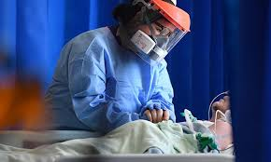
Spiritual Health: Gaps in the Era of COVID-19
Dr. Irene Mageto, (UoN)
Dr. Joyce Jebet, (UoN)
Dr. Dina Chelagat, (Moi)
Ms Caren Jerop (Alupe)

Slide 2
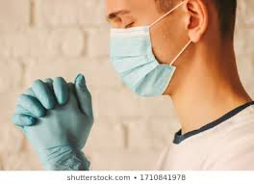
Background
Spirituality is a component of holistic care.
During COVID 19 pandemic, spiritual health has been adversely affected owing to restrictions to places of worship/ numbers.
COVID 19 has affected religious freedom
The physical/ social distancing is affecting spirituality.

Slide 3
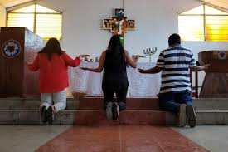
Background (Cont’d)
COVID is marred with a lot of uncertainty, offering a time for spiritual reflection.
Every time there is a disaster, the government calls for prayers and urging the religious leaders to take the lead but this time everyone was asked to stay at home.
The crisis has made people turn to prayer

Slide 4
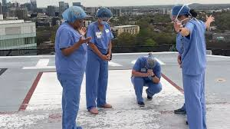
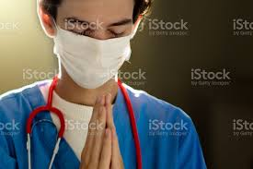
Background (Cont’d)
Frontline workers are more affected owing to the risk of infection and fear of transmission to their families.
Their work schedules may not allow them to have time to attend to their spiritual health.

Slide 5
RESEARCH QUESTIONS
Do the religious leaders communicate to their followers regarding COVID 19?
What information do the religious leaders communicate to their followers regarding COVID 19?
How do the religious leaders communicate to their followers regarding COVID 19?
When do the religious leaders communicate to their followers regarding COVID 19?

Slide 6
Methodology
This was a qualitative study that targeted the religious leaders in Eldoret town and Nairobi City.
An online key informant interview was conducted through a phone call.
Saturation was obtained after a total of six key informants were interviewed.
The interview sessions lasted between 20 – 30 minutes.
Data was transcribed, manual coding was done and thematic analysis was done.
Data was presented as narrative texts.

Slide 7
Results
Saturation was achieved after six key informants had been interviewed.
Themes established from the findings of the study included: communication with believers, information relayed, religion online and effects of COVID 19.

Slide 8
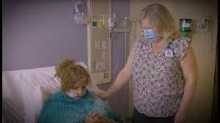
Results (Cont’d)
Communication with believers
Communication continued among the faithfuls despite COVID 19, however, those admitted in hospitals could not be reached.
“We communicate to them. It can be daily, weekly or biweekly depending on the need”. (Respondent 1)
“We reach our followers weekdays, during home church services, during TV programs”. (Respondent 4)
“We are not able to communicate to those admitted in hospital because of the restriction of visitors” (Respondent 5)

Slide 9
Results (Cont’d)
Information shared
The religious leaders shared messages of prevention of COVID 19, however they were not trained or well equipped with knowledge.
“We tell them COVID 19 is real, underlying signs and symptoms of the disease, encourage them to take precaution measures (washing hand with soap in running water or sanitizer, use facemask while in public, avoid touching mouth, eyes and nose; avoid unnecessary gathering, maintaining social distance, in case of infection, quarantine and seek medication”. (Respondent 2)
“We get information from the media houses, so we are not well equipped with knowledge on this disease because we are not trained”. (Respondent 3)

Slide 10
Results (Cont’d)
Challenges experienced
Some of the religious leaders admitted that it was not easy to begin the online platforms of reaching their followers. They cited network challenges and even the costs involved through data bundles or monthly Wi-Fi bills.
“The online communication with the believers was not easy to begin because of network issues if we wanted to do zoom calls or even the cost, that is data bundles are expensive” (Respondent 2).
“Some of us had to undergo training on how to do Zoom calls because we have never done this before”. (Respondent 4)
“Some of our believers are ‘analogue’, so telling them about having an email communication or any other digital communication is really tough”. (Respondent 6)

Slide 11
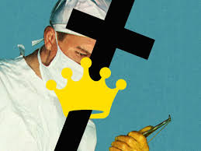
Results (Cont’d)
Challenges experienced
Some leaders also reported challenges of reaching their followers who had moved out of the town because of hard economic times. Also, they reported that they could not perform certain religious practices owing to the social distancing restrictions.
“The cost of running the Wi-Fi platforms has gone up because we spend a lot of time online now unlike before. Where we used to take one thousand shillings per month has now doubled or tripled”. (Respondent 5)
“We cannot reach some of our people because they relocated to their rural homes. Life here became hard and they decided to go since some had even lost their jobs”. (Respondent 1)
“In our church, we have not been able to perform some practices like child dedication and baptism because of the restrictions”. (Respondent 3)

Slide 12
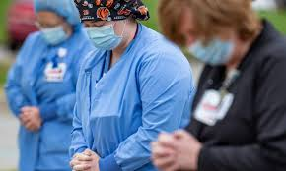
Results (Cont’d)
Negative effects of COVID 19
The negative effects of Corona virus include stigmatization of those affected and infected, negative economic effects of the virus on the churches and that some of the churches in Kenya have child care centres, which were closed during the pandemic.
“This pandemic has really affected us. We no longer hold our services the way we used to”. (Respondent 2)
“This has also affected us economically. Although some of the members send their offerings, many others don’t because they don’t come to church”. (Respondent 1)
“Socially, we have been affected because we don’t even visit people at their hour of need. For example, during funerals, the numbers are so limited”. (Respondent 3)

Slide 13
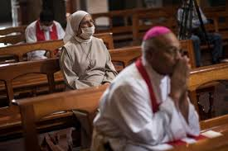
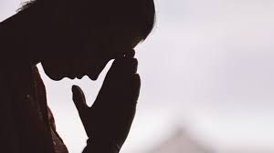
Discussion
Various modes of communication were adopted that the religious leaders and their followers could use to reach each other. Although digital platforms have been used for religious communication (Brien, 2020) religious groups found it difficult to close the doors for their churches to their members.
Religious leaders did not only share spiritual information but they also shared messages of COVID 19 pandemic to educate and reassure their followers implying that they can be very instrumental in community education (Modell & Kardia, 2020).

Slide 14
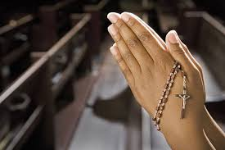
Discussion (Cont’d)
The impact of COVID 19 are global, severe and unparalleled having led to so many negative health, economic and social effects (World Council of Churches, 2020).
COVID 19 has greatly changed the lifestyles and religious rituals of different religious sects (Singh, 2020).
Despite challenges, the religious organizations continued to discharge their moral duty of reaching their faithfuls (Burke, 2020), however, religion was found to transmit the virus directly or indirectly owing to church attendance or festivities (Vermeer & Kregting, 2020).

Slide 15
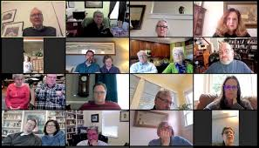
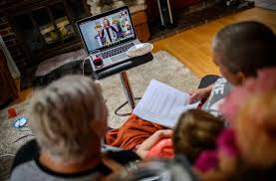
Conclusion
Spiritual health has been greatly affected by the COVID 19 pandemic.
The mode of worship, ways of communication and religious practices have been impacted.
However, this has led to innovative ways of addressing spiritual needs.

Slide 16
Recommendation
There is need to embrace technology to achieve spiritual health.
The religious community can be instrumental in spreading COVID 19 prevention messages and implementing the government regulations such as staying at home and restrictions on gatherings.

Slide 17
References
Brien, H. O. (2020). What does the rise of digital religion during Covid-19 tell us about religion’s capacity to adapt? Irish Journal of Sociology, 28(2). https://doi.org/10.1177/0791603520939819
WHO. (2020). Religious leaders join COVID-19 fight in Africa _ WHO _ Regional Office for Africa. https://www.afro.who.int/news/religious-leaders-join-covid-19-fight-africa
World Council of Churches. (2020). Statement on the Role of Churches in the Context of the COVID-19 Pandemic_ Love, Steadfastness, Hope and Courage — World Council of Churches. https://www.oikoumene.org/en/resources/documents/executive-committee/online-june-2020/statement-on-the-role-of-churches-in-the-context-of-the-covid-19-pandemic-love-steadfastness-hope-and-courage
Vermeer, P., & Kregting, J. (2020). Religion and the transmission of COVID-19 in The Netherlands. Religions, 11(8). https://doi.org/10.3390/rel11080393
Singh, R. (2020). Impact of Covid-19 on Religion and Beyond - The Geopolitics.
Modell, S. M., & Kardia, S. L. R. (2020). Religion as a Health Promoter During the 2019/2020 COVID Outbreak: View from Detroit. Journal of Religion and Health, 59(5). https://doi.org/10.1007/s10943-020-01052-1

Slide 18
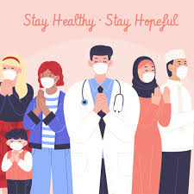
Thank you
NB: all images used in this presentation are adapted from Google images

