Slide 1
Technological Innovation in Nursing Education in the Context of COVID -19
Dr. Irene Mageto, (UoN)
Dr. Joyce Jebet, (UoN)
Dr. Dina Chelagat, (Moi)
Ms Caren Jerop (Alupe)

Slide 2
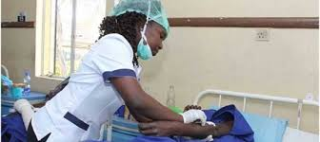
Background
Nurses make up the highest density in the health care work force.
Nursing education will lead to achievement of SDG 3 (health for all), 4 (education), 5 (gender) & 8 (economic growth) (WHO, 2020)
The COVID 19 pandemic has affected nursing education globally and led to several changes (Babita S. & Rakesh S., 2020)

Slide 3
Background (cont’d)
Well trained and competent educators lead to quality education.
Quality education leads to quality health care service provision.
There is need for highly interactive and engaging learning to compensate for face-to-face learning (Al-Ataby, 2020))

Slide 4
Background (cont’d)
Nursing education is evolving and undergoing several changes.
The unprecedented changes have led to innovation in education.
Safe care is assured with technology but needs close monitoring and prompt management.

Slide 5
Nursing education challenges during COVID
Sudden unexpected changes – lack of preparation for distance learning.
Institution closures -reduced teacher – student contact hours
Existing disparities in nursing education e.g comparing public and private (teacher-student ratio, infrastructure etc)

Slide 6
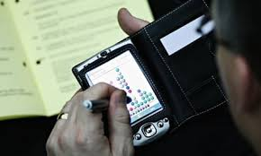
Nursing education challenges during COVID
Capacity building for both the students and trainers
Cost of running online classes
Unreliable and inaccessible internet services
Risk of psychological problems among students – halted progress in education

Slide 7
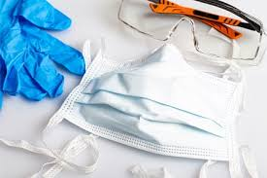
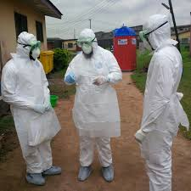
Nursing education challenges during COVID
Lack of / inadequate resources
Lack of PPEs where clinical teaching is involved
Inability to do clinical placement online

Slide 8
The innovations
“Every challenge is an opportunity”
Distance - based learning
Virtual learning – several platforms
Internet – Electronic sources
Rotational/ staggered learning
On-line examinations

Slide 9
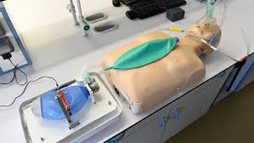
The innovations
Virtual reality simulations – 65% of nursing education programs globally are using (Lea, 2020). These provide real-life scenarios

Slide 10
The innovations
Flipped delivery model – A type of blended learning, shifts instruction to a learner-centered model. Students do background work on a topic before coming into a teaching session.

Slide 11
In patient care….
Electronic medical records data – reduce medical errors
How nurses are helping patients connect with their families
video call services – hospital visits are minimized
printing emailed photos to hang at the bedside
playing favorite music

Slide 12
Benefits of technology
Improved accessibility – students/ lecturers can access teaching at their comfort zones

Slide 13
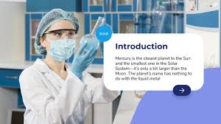
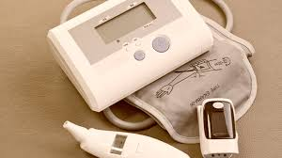
Where are we?
Adoption of technologies
Inter-sectoral collaboration – Ministry, private and public organizations e.g training, webinars etc
Extensive nursing/ midwifery research and joint collaborative projects

Slide 14
Way forward
Institutions’ collaborations with mobile operators to increase access to digital learning.
Life-long learning – change from knowledge transfer to collaborative learning (self-directed learning)
Students need to be supported to learn, not just on technology
Opportunity for entrepreneurs and investors – There is need to develop online infrastructure
Supporting collaborative inter-professional learning - networking

Slide 15
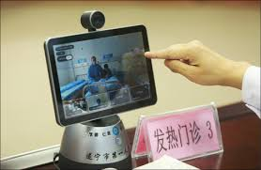
Finally…..
The most important practical lesson that can be given to nurses is to teach them what to observe—how to observe—what symptoms indicate improvement—what the reverse—which are of importance—which are of none—which are the evidence of neglect—and of what kind of neglect.
—Florence Nightingale, 1860, p. 105

Slide 16
References
Al-Ataby, A. (2020). Technology-Enhanced Learning and Teaching in COVID-19 Era: Challenges and Recommendations. International Journal for Innovation Education and Research, 8(10), 317–331. https://doi.org/10.31686/ijier.vol8.iss10.2684
World Health Organization (2020) State of the world's nursing 2020: investing in education, jobs and leadership. Available at: https://www.who.int/publications‐detail/nursing‐report‐2020.
Lea M. (2020), How VR Simulation Training Is Set to Change Nursing Education. Available at https://healthtechmagazine.net/article/2020/05/how-virtual-training-set-change-nursing-education
Babita S. & Rakesh S. (2020), Nursing Education During COVID-19 Pandemic: Way Forward for Teaching Hospitals in Nepal, Europasian Journal of Medical Sciences

Slide 17
Thank you
NB: all images used in this presentation are adapted from Google images

